Slide 1

Topic 11
Sorting and Searching
"There's nothing in your head the sorting hat can't see. So try me on and I will tell you where you ought to be."
-The Sorting Hat, Harry Potter and the Sorcerer's Stone
CS 307 Fundamentals of Computer Science
Sorting and Searching

Slide 2
Sorting and Searching
Fundamental problems in computer science and programming
Sorting done to make searching easier
Multiple different algorithms to solve the same problem
  How do we know which algorithm is "better"?
Look at searching first
Examples will use arrays of ints to illustrate algorithms
CS 307 Fundamentals of Computer Science
Sorting and Searching

Slide 3

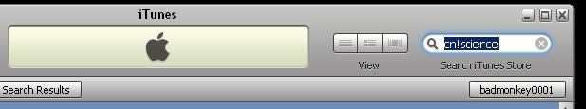
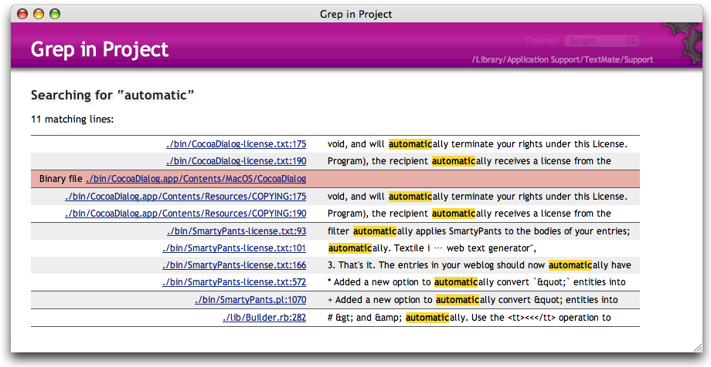
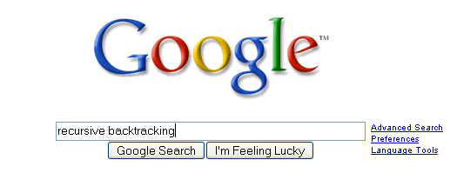
Searching
CS 307 Fundamentals of Computer Science
Sorting and Searching

Slide 4

Searching
Given a list of data find the location of a particular value or report that value is not present
linear search
  intuitive approach
  start at first item
  is it the one I am looking for?
  if not go to next item
  repeat until found or all items checked
If items not sorted or unsortable this approach is necessary
CS 307 Fundamentals of Computer Science
Sorting and Searching

Slide 5
Linear Search
/* pre: list != null
post: return the index of the first occurrence
of target in list or -1 if target not present in
list
*/
public int linearSearch(int[] list, int target) {
for(int i = 0; i < list.length; i++)
if( list[i] == target )
return i;
return -1;
}
CS 307 Fundamentals of Computer Science
Sorting and Searching

Slide 6
Linear Search, Generic
/* pre: list != null, target != null
post: return the index of the first occurrence
of target in list or -1 if target not present in
list
*/
public int linearSearch(Object[] list, Object target) {
for(int i = 0; i < list.length; i++)
if( list[i] != null && list[i].equals(target) )
return i;
return -1;
}
T(N)? Big O? Best case, worst case, average case?
CS 307 Fundamentals of Computer Science
Sorting and Searching

Slide 7
Attendance Question 1
What is the average case Big O of linear search in an array with N items, if an item is present?
O(N)
O(N²)
O(1)
O(logN)
O(NlogN)
CS 307 Fundamentals of Computer Science
Sorting and Searching

Slide 8
Searching in a Sorted List
If items are sorted then we can divide and conquer
dividing your work in half with each step
  generally a good thing
The Binary Search on List in Ascending order
  Start at middle of list
  is that the item?
  If not is it less than or greater than the item?
  less than, move to second half of list
  greater than, move to first half of list
  repeat until found or sub list size = 0
CS 307 Fundamentals of Computer Science
Sorting and Searching

Slide 9
Binary Search
list
low item middle item high item
Is middle item what we are looking for? If not is it
more or less than the target item? (Assume lower)
list
low middle high
item item item
and so forth…
CS 307 Fundamentals of Computer Science
Sorting and Searching

Slide 10
Binary Search in Action
0 1 2 3 4 5 6 7 8 9 10 11 12 13 14 15
2
3
5
7
11
13
17
19
23
29
31
37
41
43
47
53
public static int bsearch(int[] list, int target)
{ int result = -1;
int low = 0;
int high = list.length - 1;
int mid;
while( result == -1 && low <= high )
{ mid = low + ((high - low) / 2);
if( list[mid] == target )
result = mid;
else if( list[mid] < target)
low = mid + 1;
else
high = mid - 1;
}
return result;
}
// mid = ( low + high ) / 2; // may overflow!!!
// or mid = (low + high) >>> 1; using bitwise op
CS 307 Fundamentals of Computer Science
Sorting and Searching

Slide 11
Trace When Key == 3
Trace When Key == 30
Variables of Interest?
CS 307 Fundamentals of Computer Science
Sorting and Searching

Slide 12
Attendance Question 2
What is the worst case Big O of binary search in an array with N items, if an item is present?
O(N)
O(N²)
O(1)
O(logN)
O(NlogN)
CS 307 Fundamentals of Computer Science
Sorting and Searching

Slide 13
Generic Binary Search
public static int bsearch(Comparable[] list, Comparable target)
{ int result = -1;
int low = 0;
int high = list.length - 1;
int mid;
while( result == -1 && low <= high )
{ mid = low + ((high - low) / 2);
if( target.equals(list[mid]) )
result = mid;
else if(target.compareTo(list[mid]) > 0)
low = mid + 1;
else
high = mid - 1;
}
return result;
}
CS 307 Fundamentals of Computer Science
Sorting and Searching

Slide 14
Recursive Binary Search
public static int bsearch(int[] list, int target){
return bsearch(list, target, 0, list.length – 1);
}
public static int bsearch(int[] list, int target,
int first, int last){
if( first <= last ){
int mid = low + ((high - low) / 2);
if( list[mid] == target )
return mid;
else if( list[mid] > target )
return bsearch(list, target, first, mid – 1);
else
return bsearch(list, target, mid + 1, last);
}
return -1;
}
CS 307 Fundamentals of Computer Science
Sorting and Searching

Slide 15
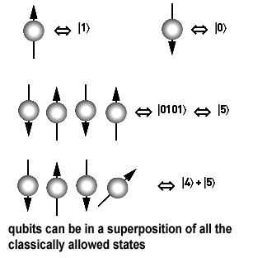
Other Searching Algorithms
Interpolation Search
  more like what people really do
Indexed Searching
Binary Search Trees
Hash Table Searching
Grover's Algorithm (Waiting for
quantum computers to be built)
best-first
A*
CS 307 Fundamentals of Computer Science
Sorting and Searching

Slide 16
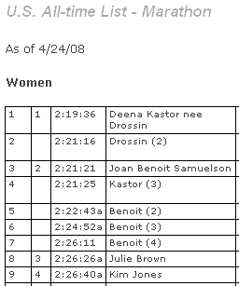
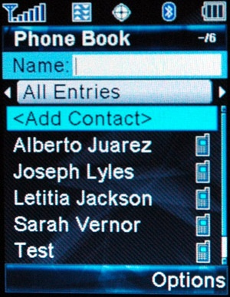
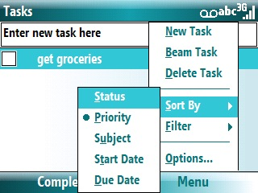
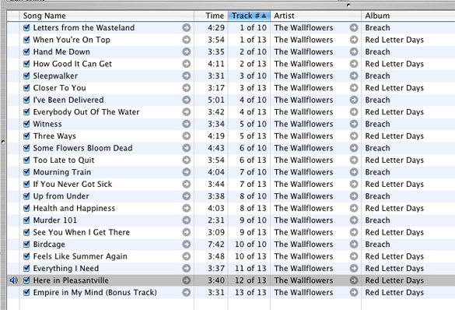
Sorting
CS 307 Fundamentals of Computer Science
Sorting and Searching

Slide 17

Sorting Fun
Why Not Bubble Sort?
CS 307 Fundamentals of Computer Science
Sorting and Searching

Slide 18
Sorting
A fundamental application for computers
Done to make finding data (searching) faster
Many different algorithms for sorting
One of the difficulties with sorting is working with a fixed size storage container (array)
  if resize, that is expensive (slow)
The "simple" sorts run in quadratic time O(N²)
  bubble sort
  selection sort
  insertion sort
CS 307 Fundamentals of Computer Science
Sorting and Searching

Slide 19
Stable Sorting
A property of sorts
If a sort guarantees the relative order of equal items stays the same then it is a stable sort
[7₁, 6, 7₂, 5, 1, 2, 7₃, -5]
  subscripts added for clarity
[-5, 1, 2, 5, 6, 7₁, 7₂, 7₃]
  result of stable sort
Real world example:
  sort a table in Wikipedia by one criteria, then another
  sort by country, then by major wins
CS 307 Fundamentals of Computer Science
Sorting and Searching

Slide 20
Selection sort
Algorithm
  Search through the list and find the smallest element
  swap the smallest element with the first element
  repeat starting at second element and find the second smallest element
public static void selectionSort(int[] list)
{ int min;
int temp;
for(int i = 0; i < list.length - 1; i++) {
min = i;
for(int j = i + 1; j < list.length; j++)
if( list[j] < list[min] )
min = j;
temp = list[i];
list[i] = list[min];
list[min] = temp;
}
}
CS 307 Fundamentals of Computer Science
Sorting and Searching

Slide 21
Selection Sort in Practice
44 68 191 119 119 37 83 82 191 45 158 130 76 153 39 25
What is the T(N), actual number of statements executed, of the selection sort code, given a list of N elements? What is the Big O?
CS 307 Fundamentals of Computer Science
Sorting and Searching

Slide 22
Generic Selection Sort
public void selectionSort(Comparable[] list)
{ int min; Comparable temp;
for(int i = 0; i < list.length - 1; i++) {
{ min = i;
for(int j = i + 1; j < list.length; j++)
if( list[min].compareTo(list[j]) > 0 )
min = j;
temp = list[i];
list[i] = list[min];
list[min] = temp;
}
}
Best case, worst case, average case Big O?
CS 307 Fundamentals of Computer Science
Sorting and Searching

Slide 23
Attendance Question 3
Is selection sort always stable?
Yes
No
CS 307 Fundamentals of Computer Science
Sorting and Searching

Slide 24
Insertion Sort
Another of the O(N^2) sorts
The first item is sorted
Compare the second item to the first
  if smaller swap
Third item, compare to item next to it
  need to swap
  after swap compare again
And so forth…
CS 307 Fundamentals of Computer Science
Sorting and Searching

Slide 25
Insertion Sort Code
public void insertionSort(int[] list)
{ int temp, j;
for(int i = 1; i < list.length; i++)
{ temp = list[i];
j = i;
while( j > 0 && temp < list[j - 1])
{ // swap elements
list[j] = list[j - 1];
list[j - 1] = temp;
j--;
}
}
}
Best case, worst case, average case Big O?
CS 307 Fundamentals of Computer Science
Sorting and Searching

Slide 26
Attendance Question 4
Is the version of insertion sort shown always stable?
Yes
No
CS 307 Fundamentals of Computer Science
Sorting and Searching

Slide 27
Comparing Algorithms
Which algorithm do you think will be faster given random data, selection sort or insertion sort?
Why?
CS 307 Fundamentals of Computer Science
Sorting and Searching

Slide 28
Sub Quadratic
Sorting Algorithms
Sub Quadratic means having a Big O better than O(N²)
CS 307 Fundamentals of Computer Science
Sorting and Searching

Slide 29
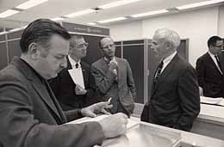
ShellSort
Created by Donald Shell in 1959
Wanted to stop moving data small distances (in the case of insertion sort and bubble sort) and stop making swaps that are not helpful (in the case of selection sort)
Start with sub arrays created by looking at data that is far apart and then reduce the gap size
CS 307 Fundamentals of Computer Science
Sorting and Searching

Slide 30
ShellSort in practice
46 2 83 41 102 5 17 31 64 49 18
Gap of five. Sort sub array with 46, 5, and 18
5 2 83 41 102 18 17 31 64 49 46
Gap still five. Sort sub array with 2 and 17
5 2 83 41 102 18 17 31 64 49 46
Gap still five. Sort sub array with 83 and 31
5 2 31 41 102 18 17 83 64 49 46
Gap still five Sort sub array with 41 and 64
5 2 31 41 102 18 17 83 64 49 46
Gap still five. Sort sub array with 102 and 49
5 2 31 41 49 18 17 83 64 102 46
Continued on next slide:
CS 307 Fundamentals of Computer Science
Sorting and Searching

Slide 31
Completed Shellsort
5 2 31 41 49 18 17 83 64 102 46
Gap now 2: Sort sub array with 5 31 49 17 64 46
5 2 17 41 31 18 46 83 49 102 64
Gap still 2: Sort sub array with 2 41 18 83 102
5 2 17 18 31 41 46 83 49 102 64
Gap of 1 (Insertion sort)
2 5 17 18 31 41 46 49 64 83 102
Array sorted
CS 307 Fundamentals of Computer Science
Sorting and Searching

Slide 32
Shellsort on Another Data Set
0 1 2 3 4 5 6 7 8 9 10 11 12 13 14 15
44 68 191 119 119 37 83 82 191 45 158 130 76 153 39 25
Initial gap = length / 2 = 16 / 2 = 8
initial sub arrays indices:
{0, 8}, {1, 9}, {2, 10}, {3, 11}, {4, 12}, {5, 13}, {6, 14}, {7, 15}
next gap = 8 / 2 = 4
{0, 4, 8, 12}, {1, 5, 9, 13}, {2, 6, 10, 14}, {3, 7, 11, 15}
next gap = 4 / 2 = 2
{0, 2, 4, 6, 8, 10, 12, 14}, {1, 3, 5, 7, 9, 11, 13, 15}
final gap = 2 / 2 = 1
CS 307 Fundamentals of Computer Science
Sorting and Searching

Slide 33
ShellSort Code
public static void shellsort(Comparable[] list)
{ Comparable temp; boolean swap;
for(int gap = list.length / 2; gap > 0; gap /= 2)
for(int i = gap; i < list.length; i++)
{ Comparable tmp = list[i];
int j = i;
for( ; j >= gap &&
tmp.compareTo( list[j - gap] ) < 0;
j -= gap )
list[ j ] = list[ j - gap ];
list[ j ] = tmp;
}
}
CS 307 Fundamentals of Computer Science
Sorting and Searching

Slide 34
Comparison of Various Sorts
Num Items | Selection | Insertion | Shellsort | Quicksort
1000 | 16 | 5 | 0 | 0
2000 | 59 | 49 | 0 | 6
4000 | 271 | 175 | 6 | 5
8000 | 1056 | 686 | 11 | 0
16000 | 4203 | 2754 | 32 | 11
32000 | 16852 | 11039 | 37 | 45
64000 | expected? | expected? | 100 | 68
128000 | expected? | expected? | 257 | 158
256000 | expected? | expected? | 543 | 335
512000 | expected? | expected? | 1210 | 722
1024000 | expected? | expected? | 2522 | 1550
times in milliseconds
CS 307 Fundamentals of Computer Science
Sorting and Searching

Slide 35

Quicksort
Invented by C.A.R. (Tony) Hoare
A divide and conquer approach
that uses recursion
If the list has 0 or 1 elements it is sorted
otherwise, pick any element p in the list. This is called the pivot value
Partition the list minus the pivot into two sub lists according to values less than or greater than the pivot. (equal values go to either)
return the quicksort of the first list followed by the quicksort of the second list
CS 307 Fundamentals of Computer Science
Sorting and Searching

Slide 36
Quicksort in Action
39 23 17 90 33 72 46 79 11 52 64 5 71
Pick middle element as pivot: 46
Partition list
23 17 5 33 39 11 46 79 72 52 64 90 71
quick sort the less than list
Pick middle element as pivot: 33
23 17 5 11 33 39
quicksort the less than list, pivot now 5
{} 5 23 17 11
quicksort the less than list, base case
quicksort the greater than list
Pick middle element as pivot: 17
and so on….
CS 307 Fundamentals of Computer Science
Sorting and Searching

Slide 37
Quicksort on Another Data Set
0 1 2 3 4 5 6 7 8 9 10 11 12 13 14 15
44 68 191 119 119 37 83 82 191 45 158 130 76 153 39 25
Big O of Quicksort?
CS 307 Fundamentals of Computer Science
Sorting and Searching

Slide 38
public static void swapReferences( Object[] a, int index1, int index2 )
{ Object tmp = a[index1];
a[index1] = a[index2];
a[index2] = tmp;
}
public void quicksort( Comparable[] list, int start, int stop )
{ if(start >= stop)
return; //base case list of 0 or 1 elements
int pivotIndex = (start + stop) / 2;
// Place pivot at start position
swapReferences(list, pivotIndex, start);
Comparable pivot = list[start];
// Begin partitioning
int i, j = start;
// from first to j are elements less than or equal to pivot
// from j to i are elements greater than pivot
// elements beyond i have not been checked yet
for(i = start + 1; i <= stop; i++ )
{ //is current element less than or equal to pivot
if(list[i].compareTo(pivot) <= 0)
{ // if so move it to the less than or equal portion
j++;
swapReferences(list, i, j);
}
}
//restore pivot to correct spot
swapReferences(list, start, j);
quicksort( list, start, j - 1 ); // Sort small elements
quicksort( list, j + 1, stop ); // Sort large elements
}
CS 307 Fundamentals of Computer Science
Sorting and Searching

Slide 39
Attendance Question 5
What is the best case and worst case Big O of quicksort?
Best Worst
O(NlogN) O(N²)
O(N²) O(N²)
O(N²) O(N!)
O(NlogN) O(NlogN)
O(N) O(NlogN)
CS 307 Fundamentals of Computer Science
Sorting and Searching

Slide 40
Quicksort Caveats
Average case Big O?
Worst case Big O?
Coding the partition step is usually the hardest part
CS 307 Fundamentals of Computer Science
Sorting and Searching

Slide 41
Attendance Question 6
You have 1,000,000 items that you will be searching. How many searches need to be performed before the data is changed to make sorting worthwhile?
10
40
1,000
10,000
500,000
CS 307 Fundamentals of Computer Science
Sorting and Searching

Slide 42
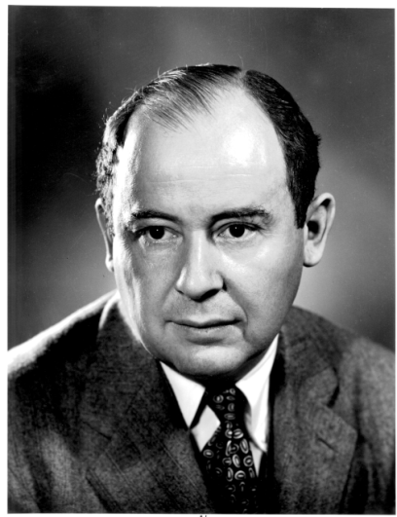

Merge Sort Algorithm
Don Knuth cites John von Neumann as the creator
of this algorithm
If a list has 1 element or 0 elements it is sorted
If a list has more than 2 split into into 2 separate lists
Perform this algorithm on each of those smaller lists
Take the 2 sorted lists and merge them together
CS 307 Fundamentals of Computer Science
Sorting and Searching

Slide 43
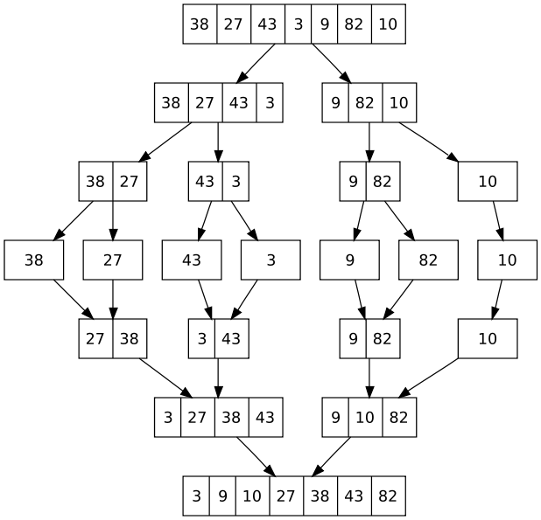
Merge Sort
When implementing
one temporary array
is used instead of
multiple temporary
arrays.
Why?
CS 307 Fundamentals of Computer Science
Sorting and Searching

Slide 44
Merge Sort code
/**
* perform a merge sort on the data in c
* @param c c != null, all elements of c
* are the same data type
*/
public static void mergeSort(Comparable[] c)
{ Comparable[] temp = new Comparable[ c.length ];
sort(c, temp, 0, c.length - 1);
}
private static void sort(Comparable[] list, Comparable[] temp, int low, int high)
{ if( low < high){
int center = (low + high) / 2;
sort(list, temp, low, center);
sort(list, temp, center + 1, high);
merge(list, temp, low, center + 1, high);
}
}
CS 307 Fundamentals of Computer Science
Sorting and Searching

Slide 45
Merge Sort Code
private static void merge( Comparable[] list, Comparable[] temp,
int leftPos, int rightPos, int rightEnd){
int leftEnd = rightPos - 1;
int tempPos = leftPos;
int numElements = rightEnd - leftPos + 1;
//main loop
while( leftPos <= leftEnd && rightPos <= rightEnd){
if( list[ leftPos ].compareTo(list[rightPos]) <= 0){
temp[ tempPos ] = list[ leftPos ];
leftPos++;
}
else{
temp[ tempPos ] = list[ rightPos ];
rightPos++;
}
tempPos++;
}
//copy rest of left half
while( leftPos <= leftEnd){
temp[ tempPos ] = list[ leftPos ];
tempPos++;
leftPos++;
}
//copy rest of right half
while( rightPos <= rightEnd){
temp[ tempPos ] = list[ rightPos ];
tempPos++;
rightPos++;
}
//Copy temp back into list
for(int i = 0; i < numElements; i++, rightEnd--)
list[ rightEnd ] = temp[ rightEnd ];
}
CS 307 Fundamentals of Computer Science
Sorting and Searching

Slide 46
Final Comments
Language libraries often have sorting algorithms in them
  Java Arrays and Collections classes
  C++ Standard Template Library
  Python sort and sorted functions
Hybrid sorts
  when size of unsorted list or portion of array is small use insertion sort, otherwise use
  O(N log N) sort like Quicksort of Mergesort
Many other sorting algorithms exist.
CS 307 Fundamentals of Computer Science
Sorting and Searching

